Slide 1
Image Processing
Chapter(3)
Part 1:Relationships between pixels
Prepared by: Hanan Hardan

Slide 2
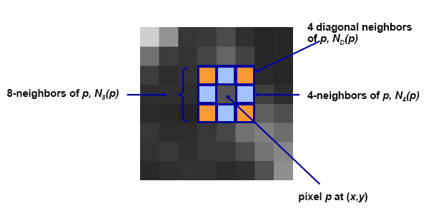
Neighbors of a pixel
Ch3: Some basic Relationships between pixels
some of the points in N_{D} (p) and N₈ (p) fall outside the image if (x,y) is on the border of the image.

Slide 3
Connectivity
Two pixels are connected if:
– They are neighbors (i.e. adjacent in some sense -- e.g. N4(p), N8(p), …)
– Their gray levels satisfy a specified criterion of similarity (e.g. equality, …)
• V is the set of gray-level values used to define adjacency (e.g. V={1} for adjacency of pixels of value 1)
هذا يعتمد على مقدار القرب الذي تاخذه بعين الاعتبار

Slide 4
Adjacency and Connectivity
Let V: a set of intensity values used to define adjacency and connectivity.
In a binary image, V = {1}, if we are referring to adjacency of pixels with value 1.
In a gray-scale image, the idea is the same, but V typically contains more elements, for example, V = {180, 181, 182, …, 200}
If the possible intensity values 0 – 255, V set can be any subset of these 256 values

Slide 5
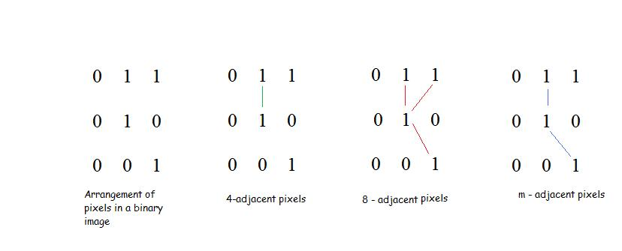
Adjacency
Ch3: Some basic Relationships between pixels
V: set of gray level values (L), (V is a subset of L.)
3 types of adjacency
4- adjacency: 2 pixels p and q with values from V are 4- adjacent if q is in the set N₄(p)
8- adjacency: 2 pixels p and q with values from V are 8- adjacent if q is in the set N₈(p)
m- adjacency: 2 pixels p and q with values from V are m-adjacent if
1. q is in N₄(p), or
2. q is in N_{D}(p) and the set N₄(p) ∩ N₄(q) has no pixels whose values are from V

Slide 6
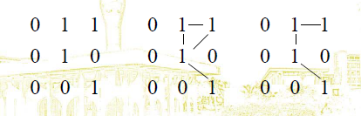
Types of Adjacency
In this example, we can note that to connect between two pixels (finding a path between two pixels):
  In 8-adjacency way, you can find multiple paths between two pixels
  While, in m-adjacency, you can find only one path between two pixels
So, m-adjacency has eliminated the multiple path connection that has been generated by the 8-adjacency.

Slide 7
Types of Adjacency
Two subsets S1 and S2 are adjacent, if some pixel in S1 is adjacent to some pixel in S2. Adjacent means, either 4-, 8- or m-adjacency.

Slide 8
A digital path
Ch3: Some basic Relationships between pixels
A digital path from pixel p with coordinates (x,y) to pixel q with coordinates (s,t) is a sequence of distinct pixels with coordinates (x0,y0), (x1,y1), …, (xn,yn), where (x0,y0)= (x,y) and (xn,yn)=(s,t), and pixels (xi,yi) and (xi-1,yi-1) are adjacent for 1 ≤ i ≤ n.
n is the length of the path
If (x₀,y₀) = (x_{n}, y_{n}), the path is closed.
We can specify 4-, 8- or m-paths depending on the type of adjacency specified.

Slide 9
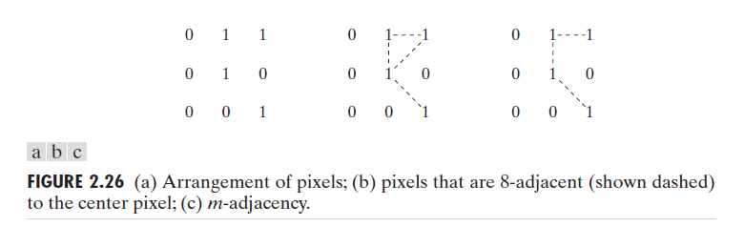
A Digital Path
Return to the previous example:
In figure (b) the paths between the top right and bottom right pixels are 8-paths. And the path between the same 2 pixels in figure (c) is m-path

Slide 10
Connectivity
Ch3: Some basic Relationships between pixels
S: a subset of pixels in an image.
Two pixels p and q are said to be connected in S if there exists a path between them consisting entirely of pixels in S.
For any pixel p in S, the set of pixels that are connected to it in S is called a connected component of S.

Slide 11
Regions and boundaries
Ch3: Some basic Relationships between pixels
Region
  Let R be a subset of pixels in an image, we call R a region of the image if R is a connected set.
  000000
  010010
  011010
  010110
  000000
Boundary
The boundary (also called border or contour) of a region R is the set of pixels in the region that have one or more neighbors that are not in R.

Slide 12
Region and Boundary
If R happens to be an entire image, then its boundary is defined as the set of pixels in the first and last rows and columns in the image.

Slide 13
Foreground and background
Suppose that the image contains K disjoint regions Rk none of which touches the image border .
Ru : the union of all regions .
(Ru)^{c :} is the complement .
so Ru is called foreground , and (Ru)^{c :} is the background .

Slide 14
Distance measures
Ch3: Some basic Relationships between pixels
If we have 3 pixels: p,q,z respectively
p with (x,y)
q with (s,t)
z with (v,w)
Then:
D (p,q) ≥ 0 ,D(p,q) = 0 iff p = q
D(p,q) = D(q,p)
D(p,z) ≤ D(p,q) + D(q,z)

Slide 15
Distance measures
Ch3: Some basic Relationships between pixels
Euclidean distance between p and q:
De(p,q) = [(x-s)² + (y-t)²]^{1/2}
D4 distance (also called city-block distance):
D4(p,q) = |x-s| + |y-t|
D8 distance (also called chessboard distance) :
D8(p,q) = max (|x-s| , |y-t|)

Slide 16
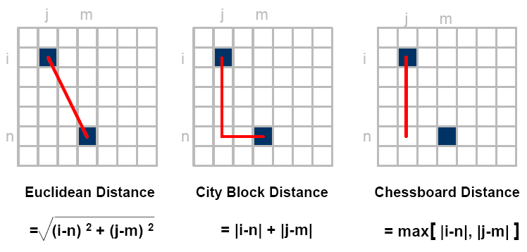
Distance measures

Slide 17
Example:
Compute the distance between the two pixels using the three distances :
q:(1,1)
P: (2,2)
Euclidian distance : ((1-2)²+(1-2)²)^{1/2} = sqrt(2).
D4(City Block distance): |1-2| +|1-2| =2
D8(chessboard distance ) : max(|1-2|,|1-2|)= 1
(because it is one of the 8-neighbors )
1 2 3
q
 | p
1
2 3

Slide 18
Distance measures
Example :
Use the city block distance to prove 4-neighbors ?
Pixel A : | 2-2| + |1-2| = 1
Pixel B: | 3-2|+|2-2|= 1
Pixel C: |2-2|+|2-3| =1
Pixel D: |1-2| + |2-2| = 1
Now as a homework try the chessboard distance to proof the 8- neighbors!!!!
1 2 3
1 2 3
 | d
a | p | c
 | b

Slide 19
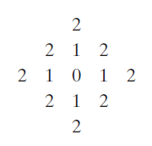
Distance Measures
Example:
The pixels with distance D₄ ≤ 2 from (x,y) form the following contours of constant distance.
The pixels with D₄ = 1 are
the 4-neighbors of (x,y)

Slide 20
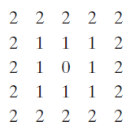
Distance Measures
Example:
D₈ distance ≤ 2 from (x,y) form the following contours of constant distance.
D8 = 1 are the 8-neighbors of (x,y)

Slide 21
Distance Measures
Dm distance:
is defined as the shortest m-path between the points.
In this case, the distance between two pixels will depend on the values of the pixels along the path, as well as the values of their neighbors.

Slide 22

Distance Measures
Example:
Consider the following arrangement of pixels and assume that p, p₂, and p₄ have value 1 and that p₁ and p₃ can have a value of 0 or 1
Suppose that we consider
the adjacency of pixels
values 1 (i.e. V = {1})

Slide 23

Distance Measures
Cont. Example:
Now, to compute the D_{m} between points p and p₄
Here we have 4 cases:
Case1: If p₁ =0 and p₃ = 0
The length of the shortest m-path
(the D_{m} distance) is 2 (p, p₂, p₄)

Slide 24

Distance Measures
Cont. Example:
Case2: If p₁ =1 and p₃ = 0
then, the length of the shortest
path will be 3 (p, p₁, p₂, p₄)

Slide 25

Distance Measures
Cont. Example:
Case3: If p₁ =0 and p₃ = 1
The same applies here, and the shortest –m-path will be 3 (p, p₂, p₃, p₄)

Slide 26

Distance Measures
Cont. Example:
Case4: If p₁ =1 and p₃ = 1
The length of the shortest m-path will be 4 (p, p₁ , p₂, p₃, p₄)

